Slide 1
MGS 723: Geodynamics
Class 23: Fluid Mechanics VI
(basic mantle plume calculations)
Main reference for today: Turcotte and Schubert textbook

Slide 2
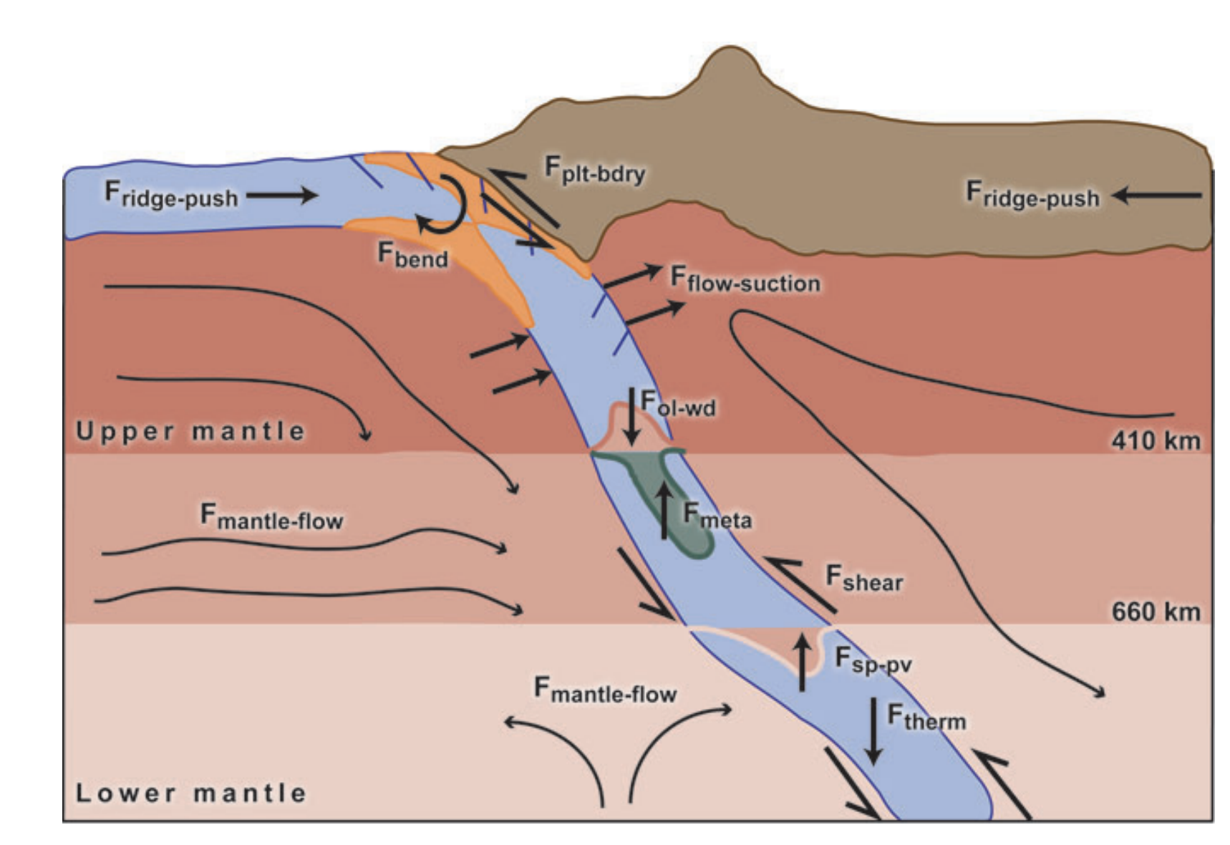
From last time: Clapeyron slope

Slide 3
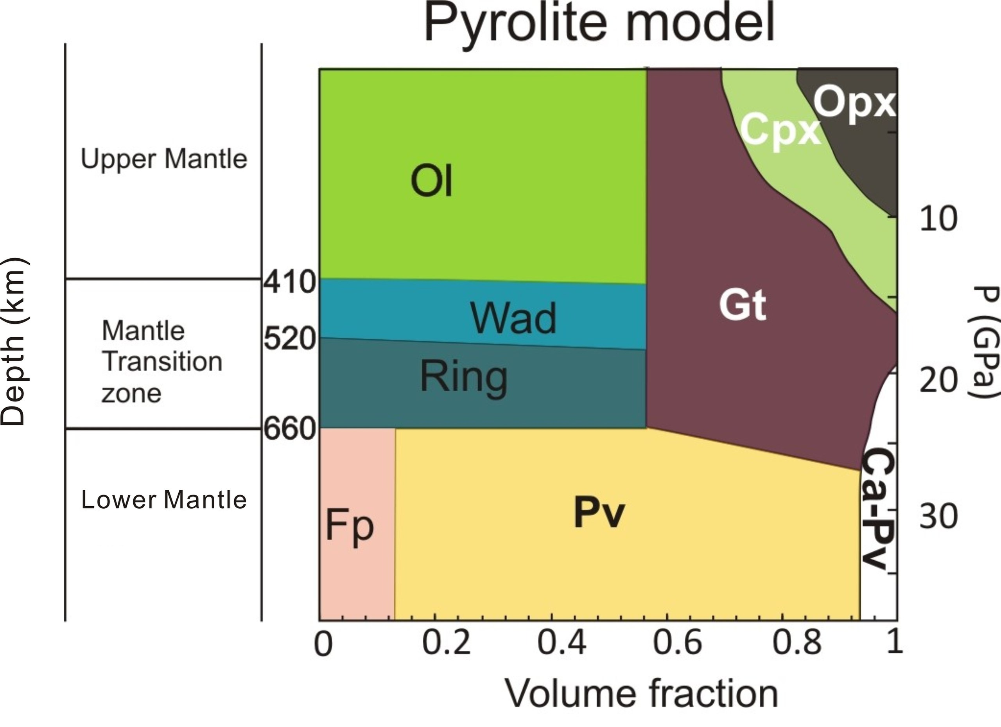
From last time: Clapeyron slope

Slide 4
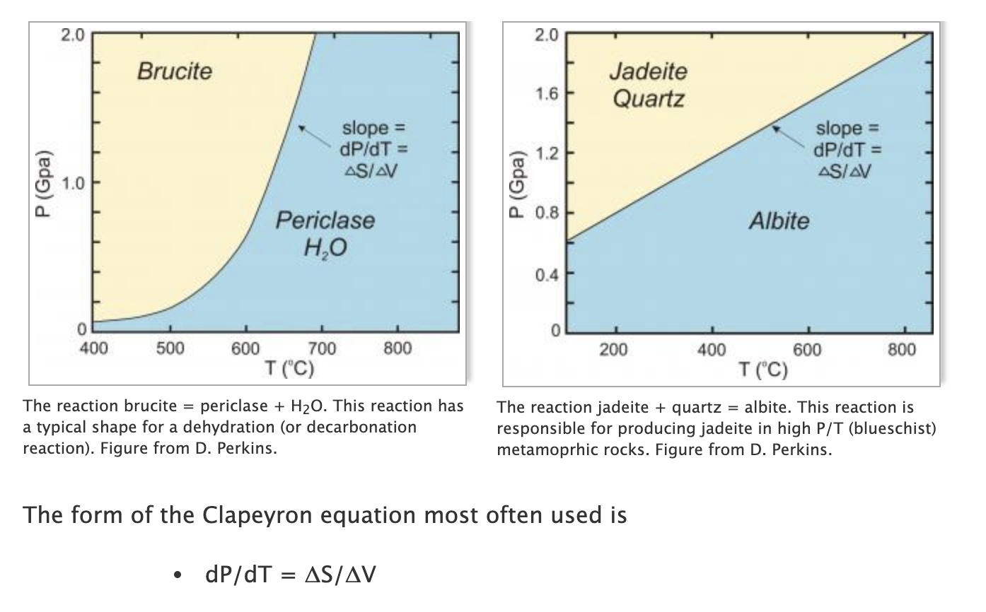
From last time: Clapeyron slope
https://serc.carleton.edu/research_education/equilibria/clapeyronequation.html

Slide 5
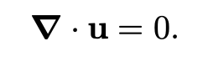

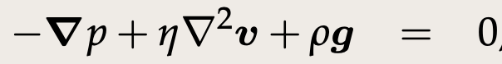
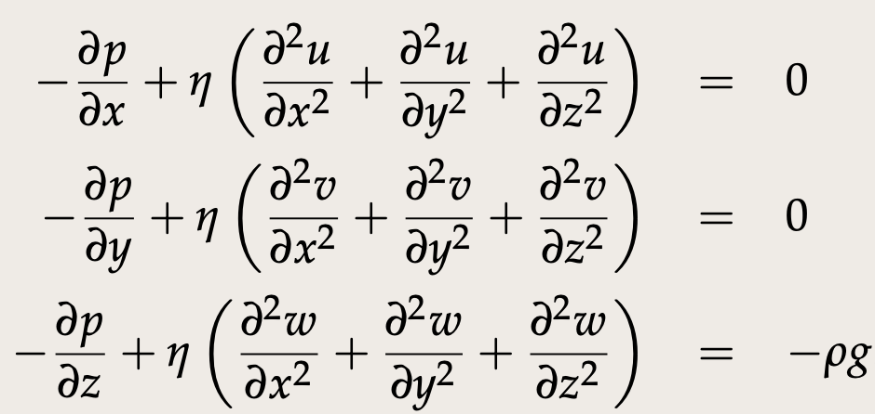
Recap: Stokes flow
Conservation
of mass
Conservation
of momentum
Vector form:
In full (Cartesian):

Slide 6
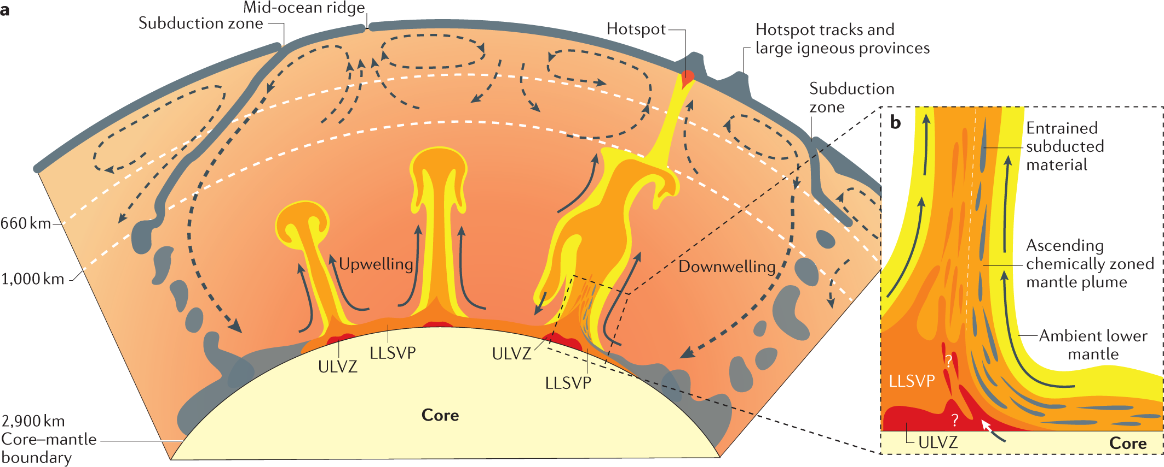
Koppers et al., 2021, Nature Reviews
Plumes: Hot, buoyant, thermo-(chemical), produce hotspots, some rooted in lowermost mantle

Slide 7
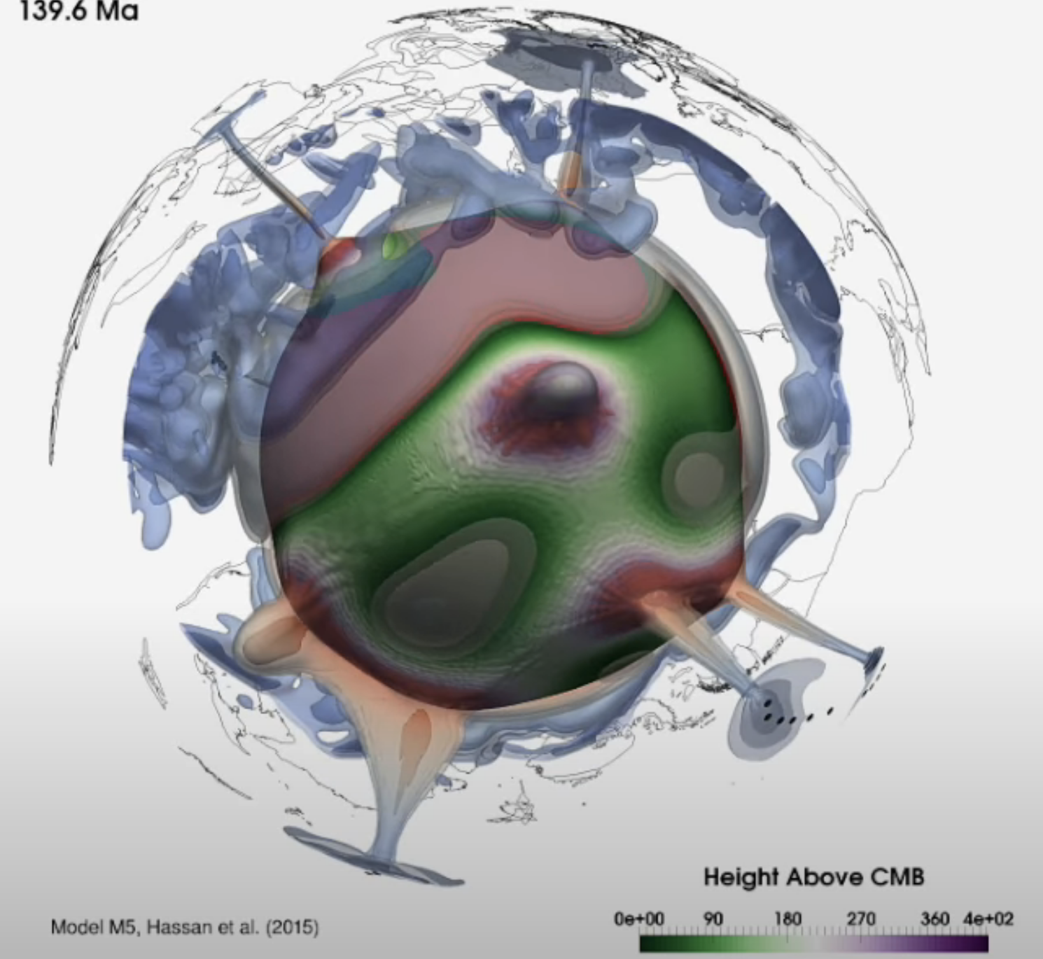
Hassan et al., 2015, G-cubed
Plumes: Hot, buoyant, thermo-(chemical), produce hotspots, some rooted in lowermost mantle

Slide 8
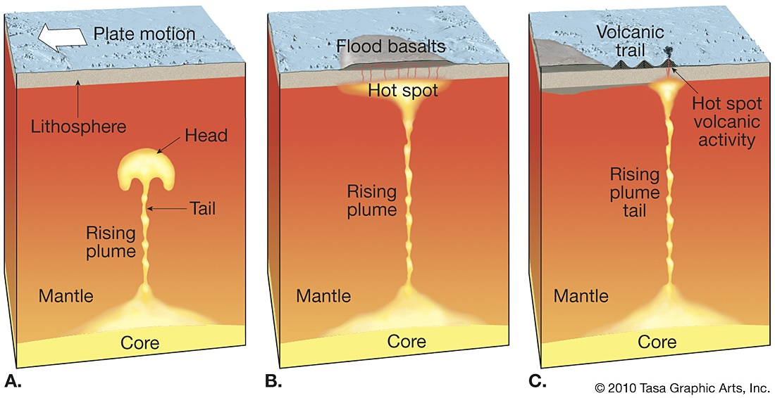
How fast do plumes heads rise through the mantle?

Slide 9
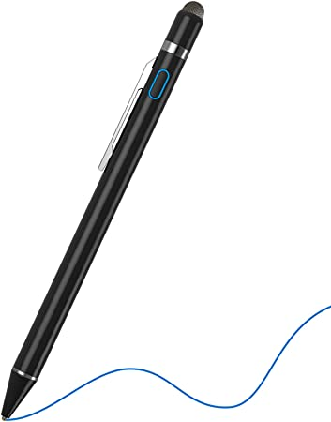
To the stylus…
Derive the Stokes sinking velocity

Slide 10
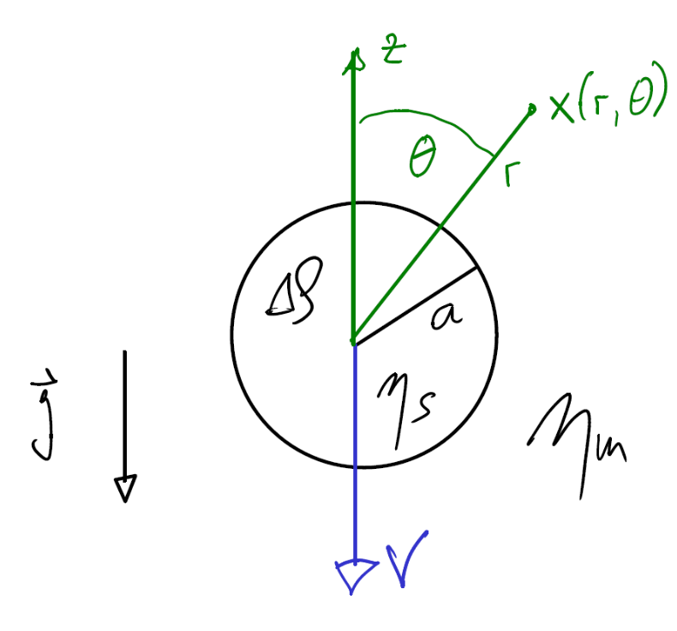
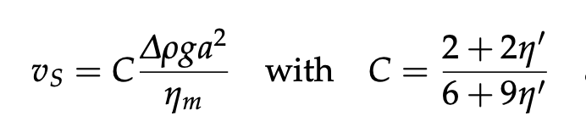
Stokes sinker
Becker and Faccenna

Slide 11
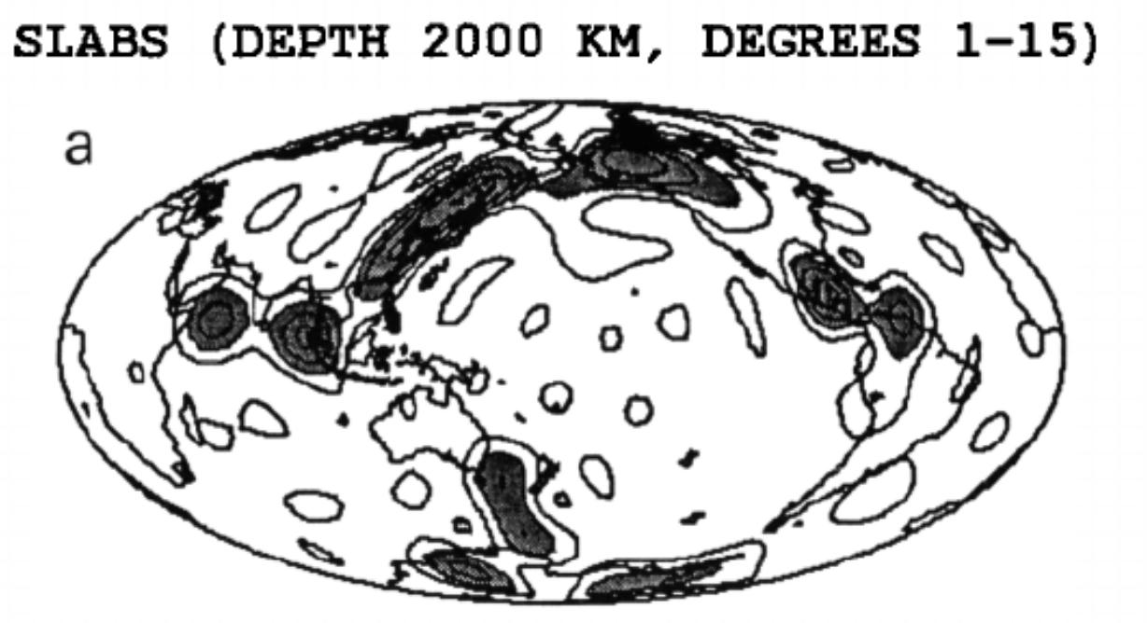
Stokes sinker
Becker and Faccenna
Can combine multiple sinkers (i.e., “slablets”) to approximate slabs)
Ricard et al., 1993, JGR

Slide 12
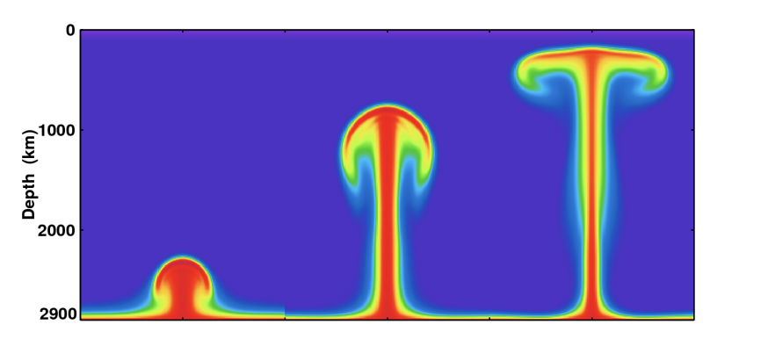
Returning to plumes

Slide 13
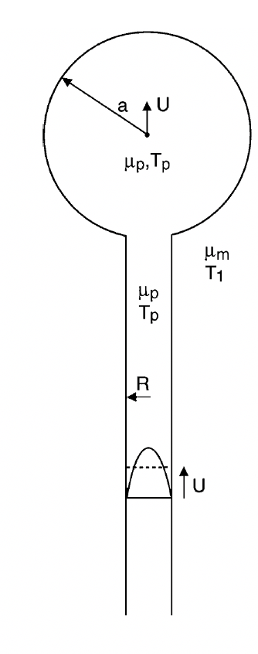
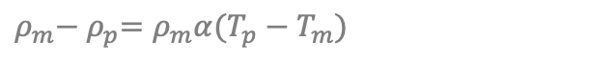
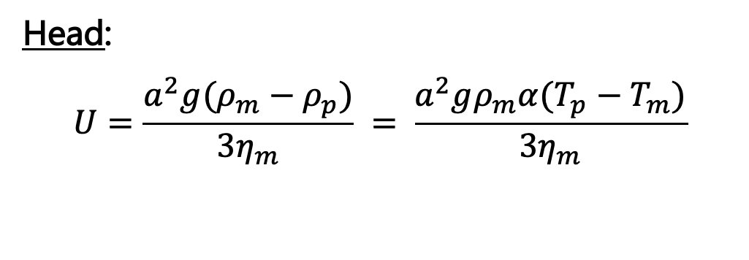
Returning to plumes
T&S, Fig. 6.33
$$ρ_{m}{− ρ}_{p}=ρ_{m}α(T_{p}−T_{m})$$
Head:
$$U=\frac{a^{2}g(ρ_{m}−ρ_{p})}{3η_{m}} = \frac{a^{2}gρ_{m}α(T_{p}−T_{m})}{3η_{m}}$$

Slide 14
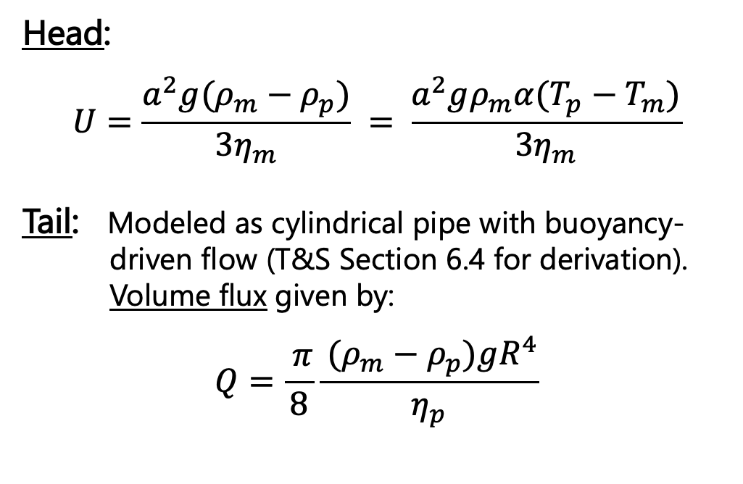
Returning to plumes
T&S, Fig. 6.33
$$ρ_{m}{− ρ}_{p}=ρ_{m}α(T_{p}−T_{m})$$
Head:
$$U=\frac{a^{2}g(ρ_{m}−ρ_{p})}{3η_{m}} = \frac{a^{2}gρ_{m}α(T_{p}−T_{m})}{3η_{m}}$$
Tail: Modeled as cylindrical pipe with buoyancy- driven flow (T&S Section 6.4 for derivation). Volume flux given by:
$$Q=\frac{ π}{8}\frac{ (ρ_{m}−ρ_{p})gR^{4}}{η_{p}}$$
[m³s⁻¹]

Slide 15

Returning to plumes
T&S, Fig. 6.33
$$ρ_{m}{− ρ}_{p}=ρ_{m}α(T_{p}−T_{m})$$
Head:
$$U=\frac{a^{2}g(ρ_{m}−ρ_{p})}{3η_{m}} = \frac{a^{2}gρ_{m}α(T_{p}−T_{m})}{3η_{m}}$$
Tail: Modeled as cylindrical pipe with buoyancy- driven flow (T&S Section 6.4 for derivation). Volume flux given by:
$$Q=\frac{ π}{8}\frac{ (ρ_{m}−ρ_{p})gR^{4}}{η_{p}}$$
$$Q=UπR^{2}$$
[m³s⁻¹]

Slide 16
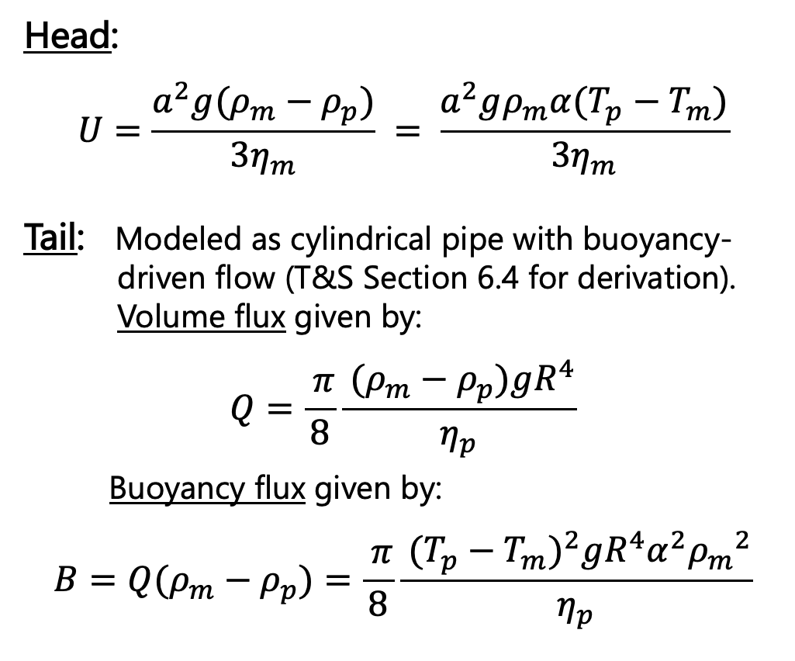
Returning to plumes
T&S, Fig. 6.33
$$ρ_{m}{− ρ}_{p}=ρ_{m}α(T_{p}−T_{m})$$
Head:
$$U=\frac{a^{2}g(ρ_{m}−ρ_{p})}{3η_{m}} = \frac{a^{2}gρ_{m}α(T_{p}−T_{m})}{3η_{m}}$$
Tail: Modeled as cylindrical pipe with buoyancy- driven flow (T&S Section 6.4 for derivation). Volume flux given by:
$$Q=\frac{ π}{8}\frac{ (ρ_{m}−ρ_{p})gR^{4}}{η_{p}}$$
Buoyancy flux given by:
$$B=Q(ρ_{m}−ρ_{p})=\frac{ π}{8}\frac{ {(T_{p}−T_{m})}^{2}gR^{4}α^{2}{ρ_{m}}^{2}}{η_{p}}$$
[m³s⁻¹]
[kgs⁻¹]

Slide 17
Returning to plumes
T&S, Fig. 6.33
$$ρ_{m}{− ρ}_{p}=ρ_{m}α(T_{p}−T_{m})$$
Head:
$$U=\frac{a^{2}g(ρ_{m}−ρ_{p})}{3η_{m}} = \frac{a^{2}gρ_{m}α(T_{p}−T_{m})}{3η_{m}}$$
Tail: Modeled as cylindrical pipe with buoyancy- driven flow (T&S Section 6.4 for derivation). Volume flux given by:
$$Q=\frac{ π}{8}\frac{ (ρ_{m}−ρ_{p})gR^{4}}{η_{p}}$$
Buoyancy flux given by:
$$B=Q(ρ_{m}−ρ_{p})=\frac{ π}{8}\frac{ {(T_{p}−T_{m})}^{2}gR^{4}α^{2}{ρ_{m}}^{2}}{η_{p}}$$
[m³s⁻¹]
[kgs⁻¹]
Heat flux: $Q_{H}=ρ_{m}c\left(T_{p}−T_{m}\right)Q=cB/α$
[J/S = W]
Notes:
Thermal expansivity = The relative expansion (also called strain) divided by the change in temperature is called the material's coefficient of linear thermal expansion and varies with temperature.
Specific heat = the heat required to raise the temperature of the unit mass of a given substance by a given amount (usually one degree).

Slide 18
Returning to plumes
T&S, Fig. 6.33
$$ρ_{m}{− ρ}_{p}=ρ_{m}α(T_{p}−T_{m})$$
Head:
$$U=\frac{a^{2}g(ρ_{m}−ρ_{p})}{3η_{m}} = \frac{a^{2}gρ_{m}α(T_{p}−T_{m})}{3η_{m}}$$
Tail: Modeled as cylindrical pipe with buoyancy- driven flow (T&S Section 6.4 for derivation). Volume flux given by:
$$Q=\frac{ π}{8}\frac{ (ρ_{m}−ρ_{p})gR^{4}}{η_{p}}$$
Buoyancy flux given by:
$$B=Q(ρ_{m}−ρ_{p})=\frac{ π}{8}\frac{ {(T_{p}−T_{m})}^{2}gR^{4}α^{2}{ρ_{m}}^{2}}{η_{p}}$$
[m³s⁻¹]
[kgs⁻¹]
Heat flux: $Q_{H}=ρ_{m}c\left(T_{p}−T_{m}\right)Q=cB/α$
[J/S = W]
Can estimate observationally

Slide 19
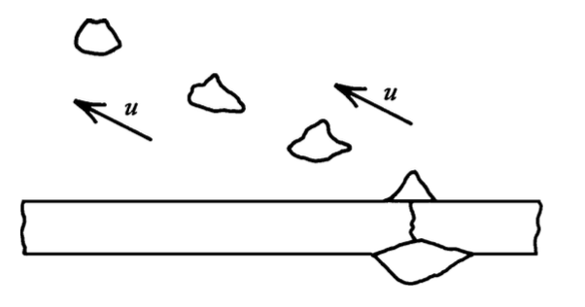
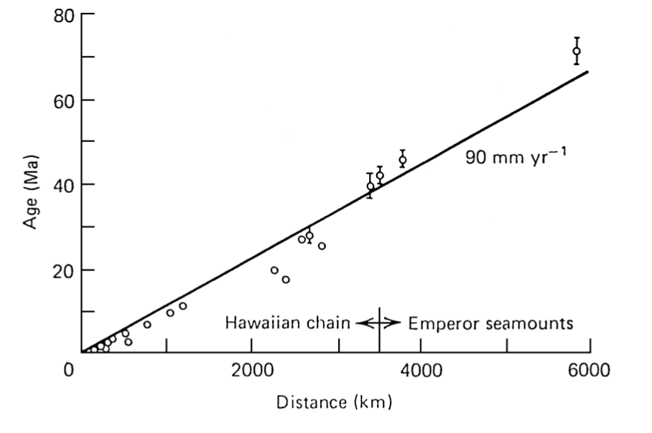
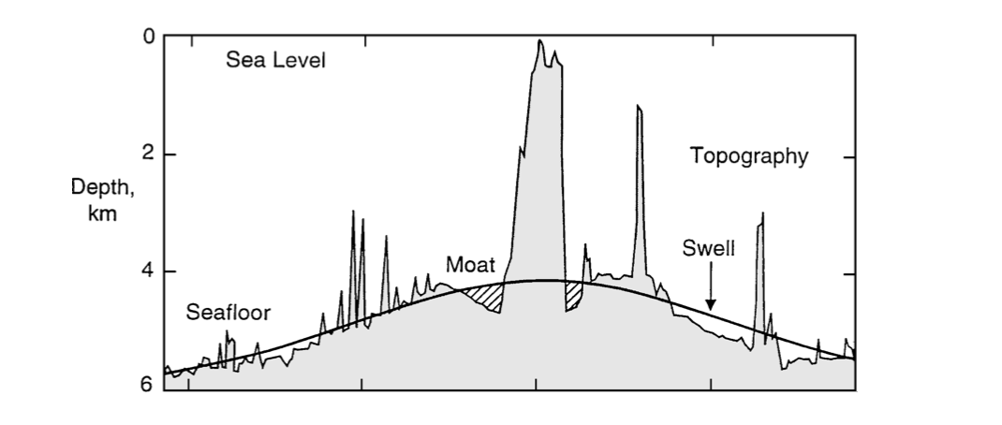
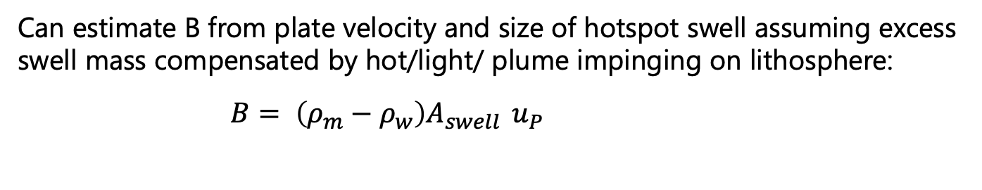
Hawaiian plume
Oahu
T&S
Can estimate B from plate velocity and size of hotspot swell assuming excess swell mass compensated by hot/light/ plume impinging on lithosphere:
$$B= \left(ρ_{m}−ρ_{w}\right)A_{swell}{ u}_{P}=7.4×{10}^{3} kg/s$$

Slide 20

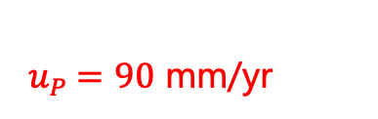
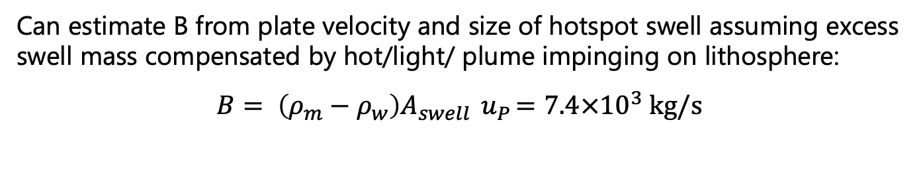
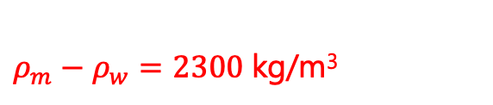
Hawaiian plume
Oahu
${ A}_{swell} =1.13$km²
${ u}_{P} =90$ mm/yr
$ρ_{m}−ρ_{w}=2300$kg/m³
T&S
Can estimate B from plate velocity and size of hotspot swell assuming excess swell mass compensated by hot/light/ plume impinging on lithosphere:
$$B= \left(ρ_{m}−ρ_{w}\right)A_{swell}{ u}_{P}=7.4×{10}^{3} kg/s$$

Slide 21
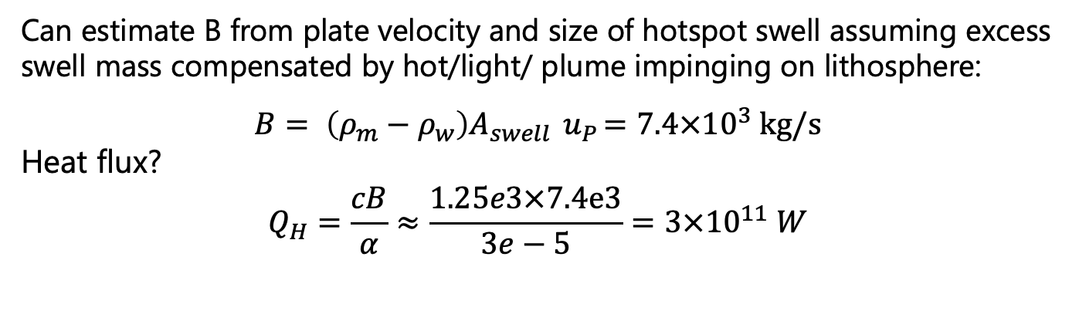
Hawaiian plume
Oahu
${ A}_{swell} =1.13$km²
${ u}_{P} =90$ mm/yr
$ρ_{m}−ρ_{w}=2300$kg/m³
Can estimate B from plate velocity and size of hotspot swell assuming excess swell mass compensated by hot/light/ plume impinging on lithosphere:
$$B= \left(ρ_{m}−ρ_{w}\right)A_{swell}{ u}_{P}=7.4×{10}^{3} kg/s$$
Heat flux?
$$Q_{H}=\frac{cB}{α}≈\frac{1.25e3×7.4e3}{3e−5}=3×{10}^{11} W$$

Slide 22
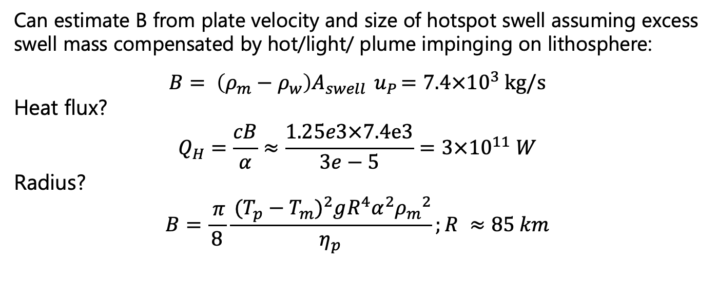
Hawaiian plume
Oahu
${ A}_{swell} =1.13$km²
${ u}_{P} =90$ mm/yr
$ρ_{m}−ρ_{w}=2300$kg/m³
Can estimate B from plate velocity and size of hotspot swell assuming excess swell mass compensated by hot/light/ plume impinging on lithosphere:
$$B= \left(ρ_{m}−ρ_{w}\right)A_{swell}{ u}_{P}=7.4×{10}^{3} kg/s$$
Heat flux?
$$Q_{H}=\frac{cB}{α}≈\frac{1.25e3×7.4e3}{3e−5}=3×{10}^{11} W$$
Radius?
$$B=\frac{ π}{8}\frac{ {(T_{p}−T_{m})}^{2}gR^{4}α^{2}{ρ_{m}}^{2}}{η_{p}};R ≈85 km$$
^{(Hard to detect seismically)}

Slide 23

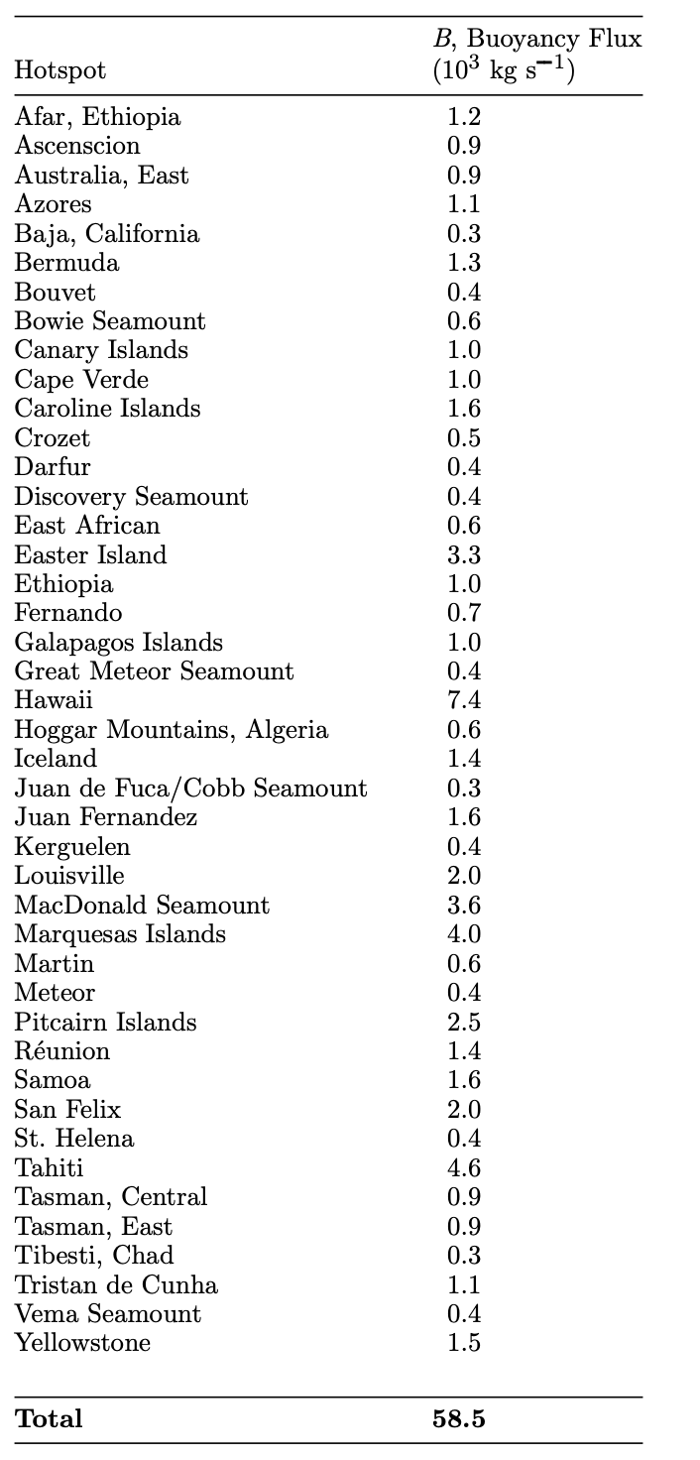
Global plumes and hotspots

Slide 24
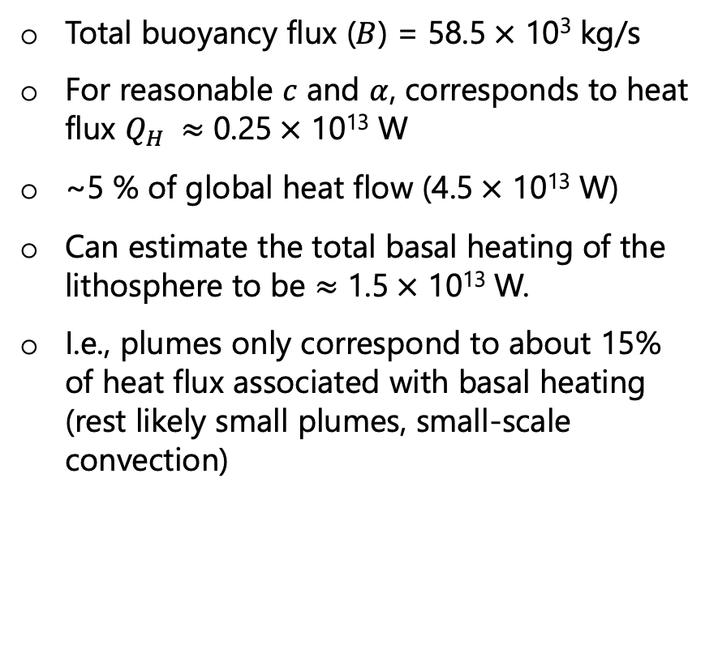
Global plumes and hotspots
Total buoyancy flux ($B$) = 58.5$×$ 10³ kg/s
For reasonable $c$ and $α$, corresponds to heat flux $Q_{H} ≈$ 0.25$×$ 10¹³ W
~5 % of global heat flow (4.5$×$ 10¹³ W)
Can estimate the total basal heating of the lithosphere to be $≈$ 1.5$×$ 10¹³ W.
I.e., plumes only correspond to about 15% of heat flux associated with basal heating (rest likely small plumes, small-scale convection)

Slide 25
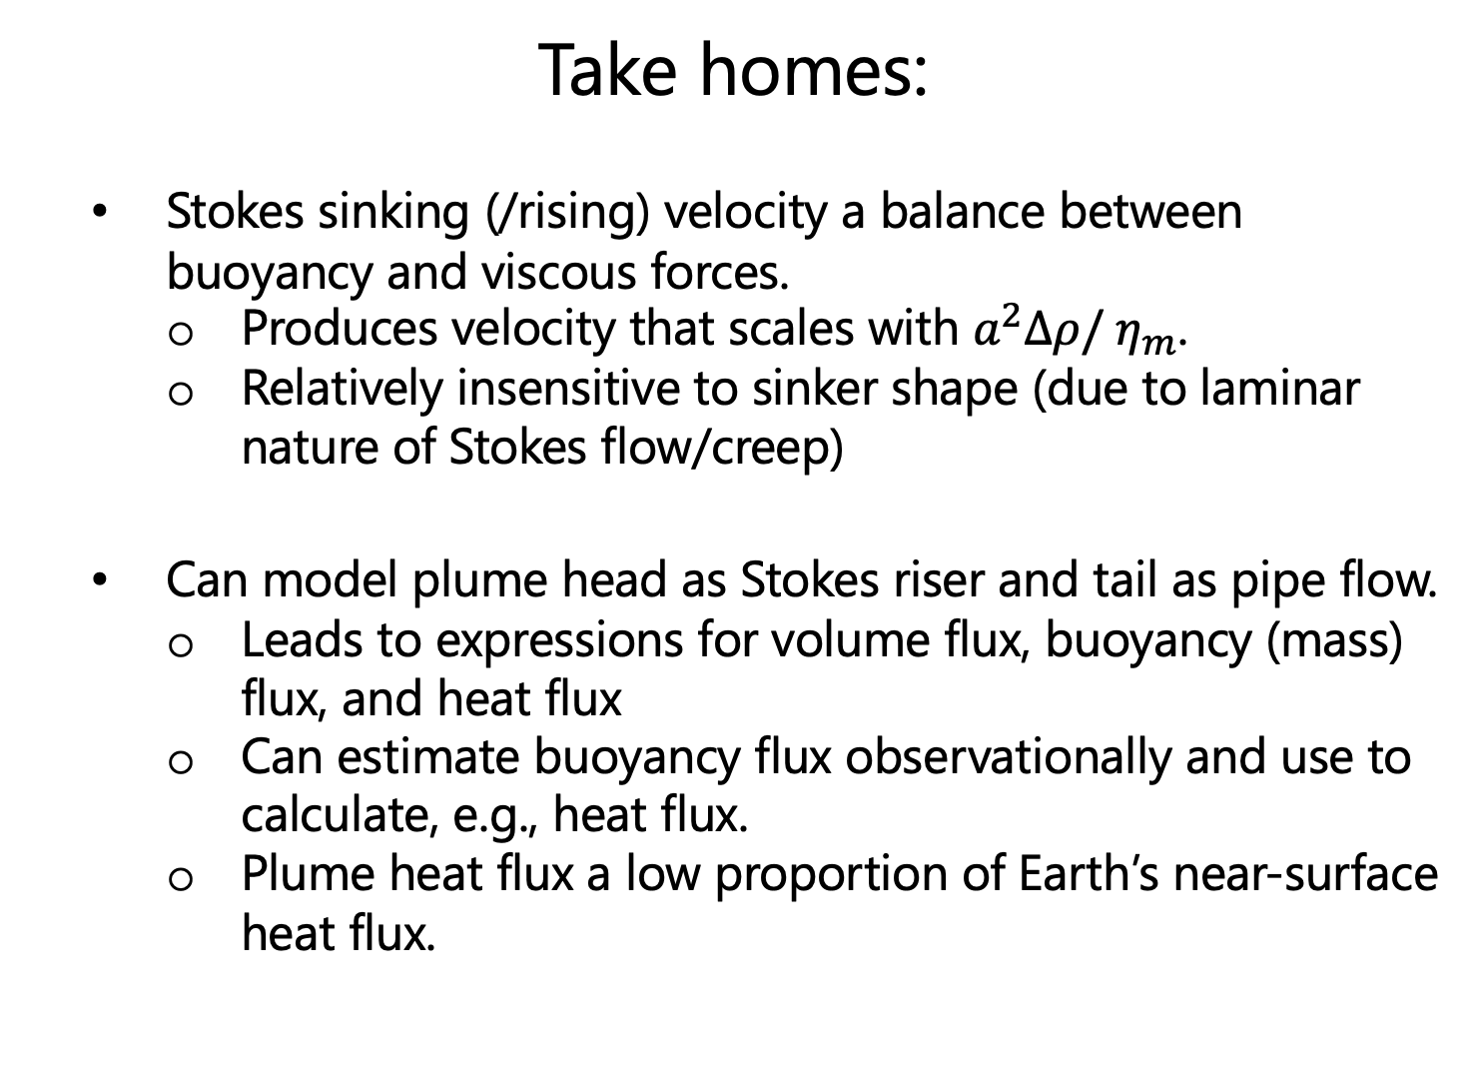
Take homes:
Stokes sinking (/rising) velocity a balance between buoyancy and viscous forces.
Produces velocity that scales with $a^{2}∆ρ/$ $η_{m}$.
Relatively insensitive to sinker shape (due to laminar nature of Stokes flow/creep)
Can model plume head as Stokes riser and tail as pipe flow.
Leads to expressions for volume flux, buoyancy (mass) flux, and heat flux
Can estimate buoyancy flux observationally and use to calculate, e.g., heat flux.
Plume heat flux a low proportion of Earth’s near-surface heat flux.

